Slide 1
MACRO/OSPE2
Dr Salma Al-Ramadhani MBBS MD (Res) FRCPath
Consultant Histopathologist Princess Alexandra Hospital

Slide 2
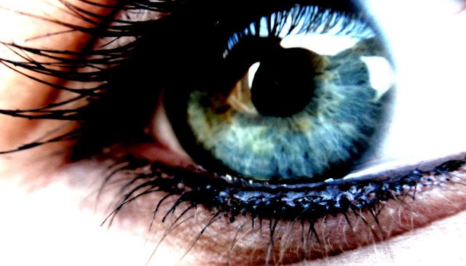
Dissection Discussion

Slide 3
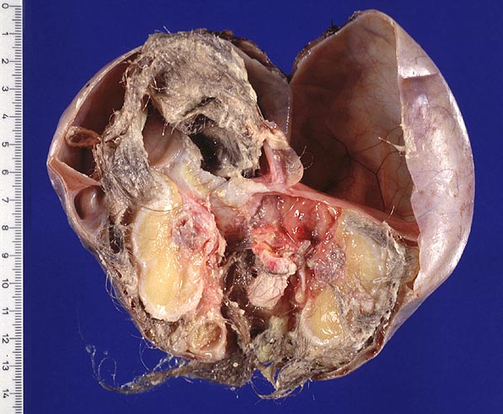
Macro Question 1 Ovary
What is the most likely diagnosis?
How would you sample this specimen?
What are the possible complications?

Slide 4
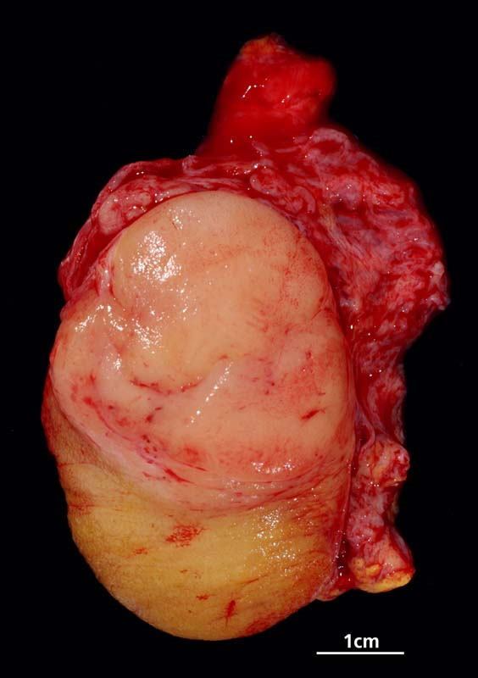
Macro Question 2 Testis
What is the most likely diagnosis?
How would you sample this specimen?
Name three core macroscopic features. Which one has prognostic significance?

Slide 5
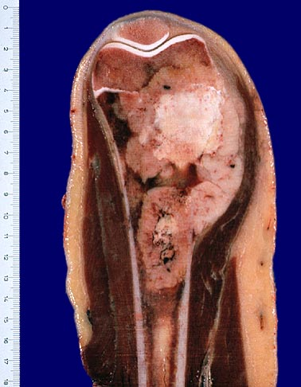
Macro Question 3 Bone
What is the most likely diagnosis?
How would you sample this specimen?
How would you grade the tumour?

Slide 6
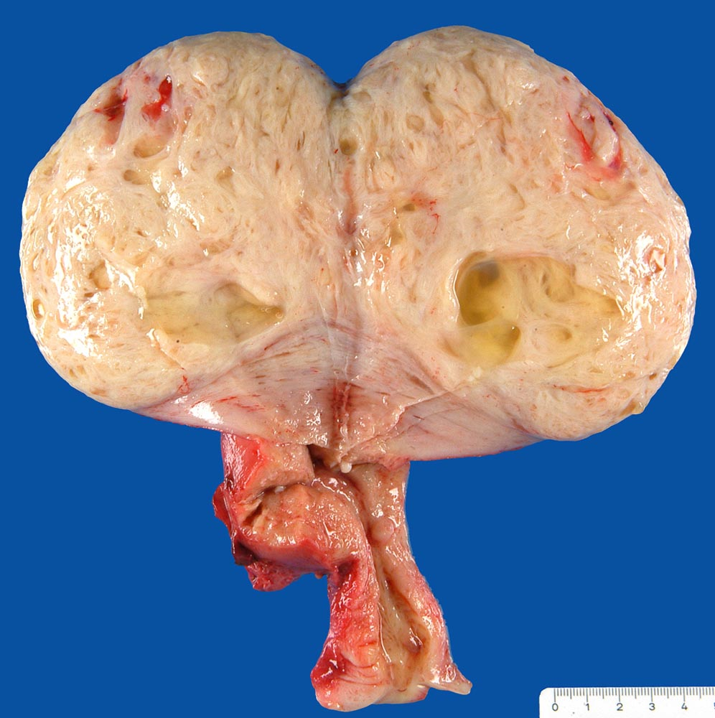
Macro Question 4 Uterus
What is the most likely diagnosis?
How would you sample this specimen?
What ancillary studies help confirm your diagnosis?

Slide 7
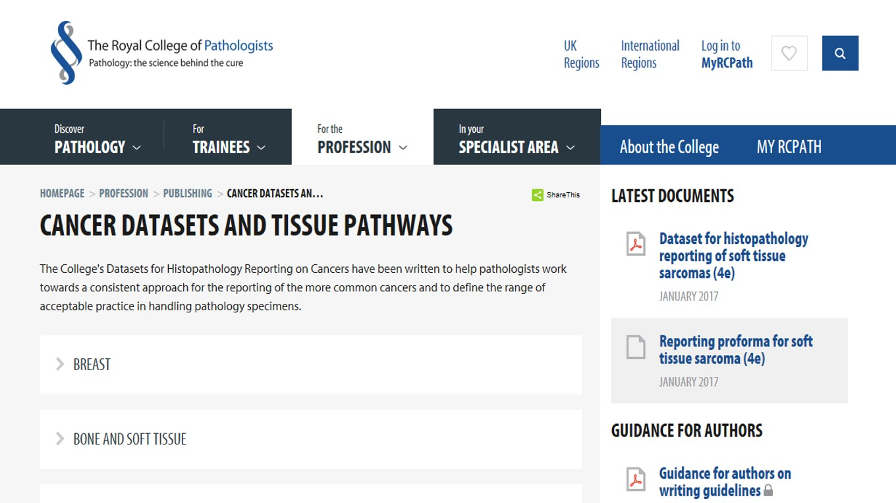

Slide 8
There are around 60 !
Don’t Panic ..

Slide 9
Start with …
(1)
Specialties you are NOT familiar with
Make simple drawings
Summarise the staging system
(2)
Complex anatomy e.g.
Bone resections
Larynx & neck dissection
Whipple
Panproctocolectomy
(3)
Watch out for updates:
New classifications
Updated documents

Slide 10
OSPE 2 Written Exercise

Slide 11
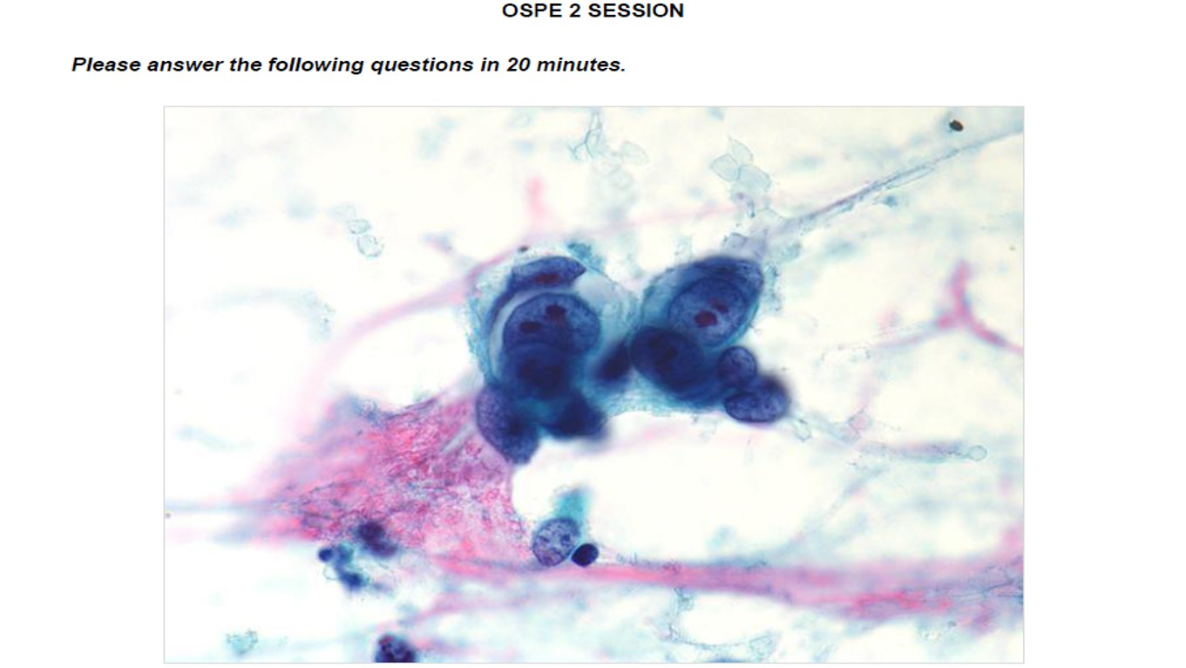
OSPE 2
Possible topics include:
Management
Clinical governance
Audit
MDT type cases
Cytology
Molecular
Collect previous exams questions
Watch out for updates:
New classifications
Updated documents

Slide 12
Previous Exams
2013 S Audit and Dataset: Colorectal CA
2013 A Dataset: Endometrial CA
2014 S Dataset: Breast CA grossing, reporting and grading
2014 A Lung CA: Cytology and molecular
2015 S Molecular Pathology: Lynch syndrome
2016 S Dataset: Prostate CA reporting
2016 A Lung CA: Cytology and molecular
2017 S Molecular Pathology: Lynch syndrome and microsatellite instability in colon CA
2017 A Molecular Pathology: p53 and BRCA in breast and ovarian CA

